Slide 1
EVSE Power ratings
 | Power level | Current type | Compatible EV segments
Normal power charging | P < 7KW | AC & DC | E-2Ws, e-3Ws, e-cars,other LCVs (up to 1 ton)
 | 7KW < P < 22KW | AC & DC
High power Charging | 22KW < P < 50KW | DC | E-Cars, LCVs and MCVs (1-6 Tons)
 | 50KW < P < 200KW | DC

Slide 2
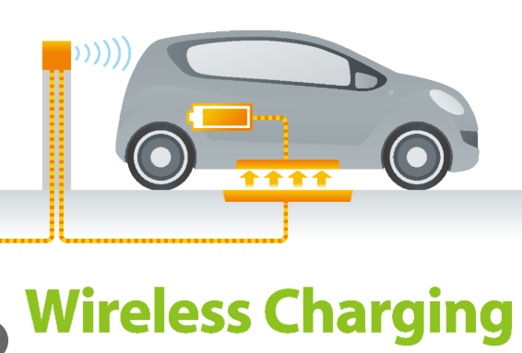
Inductive charging

Slide 3
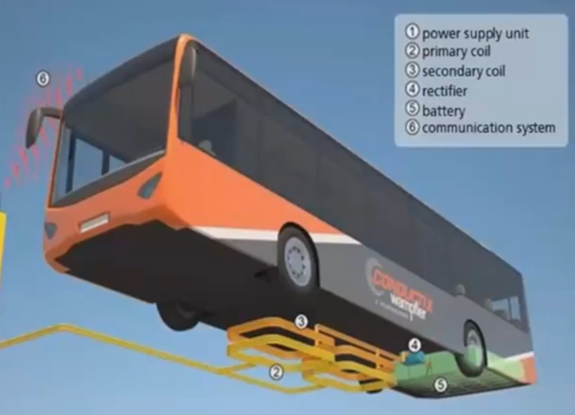
Types of EV Charging: lnductive
The power supply unit supplies the primary coil with energy.
The electric Current in the primary coil creates an electro-magnetic alternating field.
The electromagnetic alternating field allows for the transmission of energy from the primary to the secondary coil to charge the battery of the electric vehicle without the two components coming into contact with each other.

Slide 4
EV Charging Methods
Conductive Charging
Inductive Charging
Battery Swapping

Slide 5
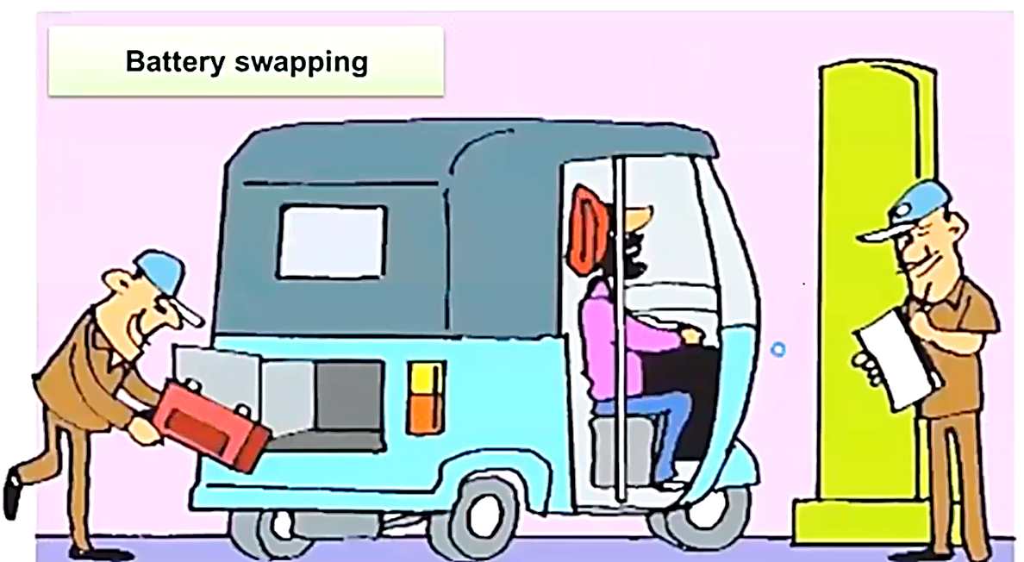
Battery swapping

